Slide 1

HEALTHCARE ANALYSIS:
RESPIRATORY
ILLNESS
PRESENTED BY THE S3 AMIGOS
JASMINE JIANG | ETTIONE STUCKEY II | JUSTIN QUINN

Slide 2
TABLE OF CONTENTS
01
Overview
02
Schema
03
Setting up S3
04
Setting up RDS
05
Lambda to RDS
06
RDS to Analysis
07
Hosting on EC2
08
Lessons Learned

Slide 3
YIKES!
Respiratory illness is an ever-growing problem, threatening the lives of Americans all across the country …

Slide 4
YAY!
The good news is, The S3 Amigos are on the case! With our skills in data analytics and AWS, we can recognize trends and patterns in the data and provide a basis on which future healthcare strategies will be developed!

Slide 5
TEAM STRATEGY:
DIVIDE & CONQUER

Slide 6
OBJECTIVES
Create a working pipeline from file upload to cloud RDS
Clean data via deployed Lambda function
Upload data to RDS
Connect locally to RDS to generate analytics
Display analytics results on EC2-hosted website

Slide 7
02
SCHEMA

Slide 8
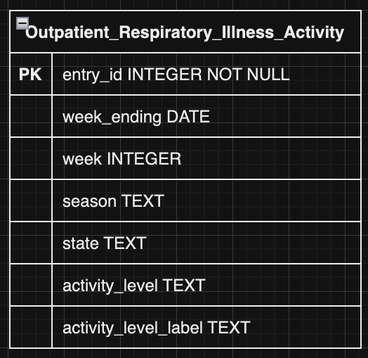
ER DIAGRAM

Slide 9

AWS ARCHITECTURE
Let’s take a look at how our AWS services are set up and connected to each other.

Slide 10
03
CHECKPOINT 1:
SETTING UP THE S3

Slide 11



CONFIGURATION: S3
Select a region
Create a name
Block public access
That’s it! The S3 has been created.

Slide 12
04
CHECKPOINT 2:
SETTING UP THE RDS

Slide 13
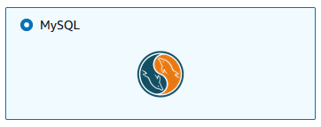
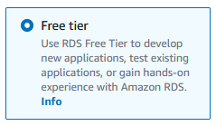
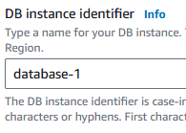
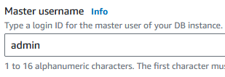

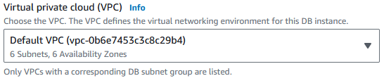
CONFIGURATION: RDS
Select an engine & template
Set db identifier & credentials
Select the default VPC

Slide 14
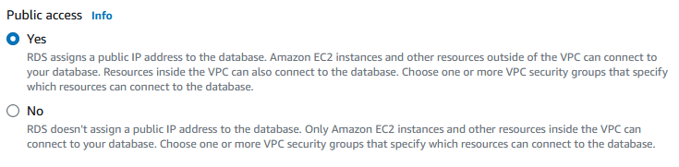

WHOA!
Remember to set your RDS public access to “yes”. Failure to do so could cause complications when trying to access the database with other services!

Slide 15
05
CHECKPOINT 3:
LAMBDA TO RDS

Slide 16
CONNECTING TO DATABASE
Created new Lambda function
Assigned appropriate permissions and security groups
Used Pymysql library to create connection to RDS database and to clean data
Attached function to S3 trigger

Slide 17
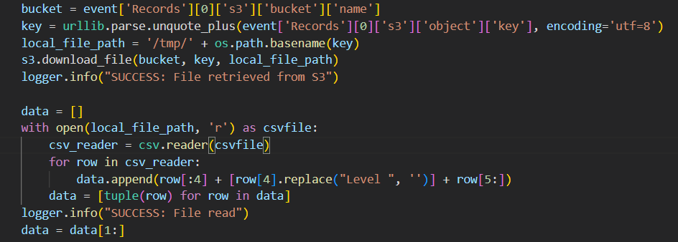
POPULATING DATABASE
Downloaded .csv file from S3 bucket into /tmp folder
Cleaned the extracted data
Executed insert statement with parsed list of tuples

Slide 18
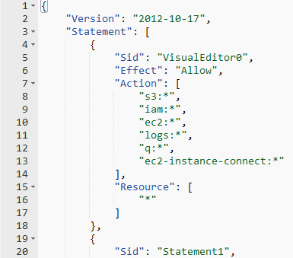
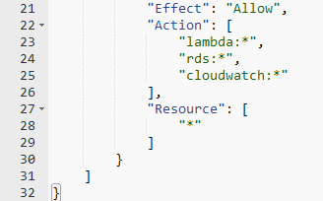
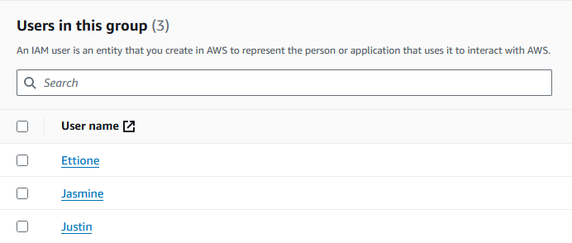
PERMISSIONS: IAM
Although our resources have now been configured, there are still a few things that need to be done before the team can access them.
IAM users must be created for all group members.
IAM users must be added to a group.
A policy must be created and added to the group.

Slide 19
06
CHECKPOINT 4:
RDS TO ANALYSIS

Slide 20

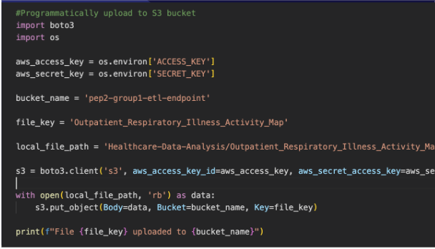
Upload to the S3 Bucket
Be sure to keep those keys private!

Slide 21

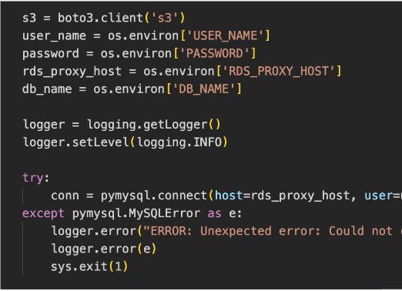
Connect to RDS + Upload CSV
Be sure you have the correct RDS Proxy Host and DB Name.
Using Try-Except blocks is good practice!

Slide 22
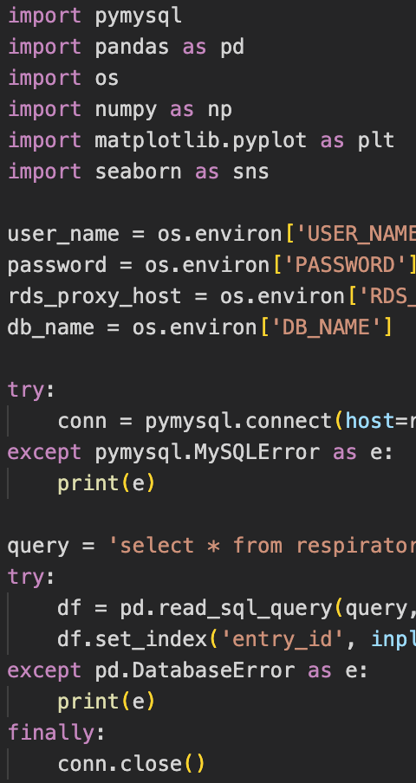

Pull from RDS + Convert to Dataframe
Double check your queries to ensure everything runs smoothly.
Congrats! You are now ready to do some analysis!

Slide 23
07
EXTENSION:
HOSTING ON EC2

Slide 24

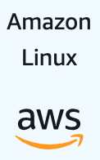

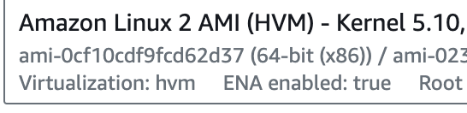


Creating the EC2
Step 1: Enter EC2 Dashboard
Step 2: Select ‘Instances’
Step 3: Launch an Instance
Step 4: Select OS
Step 5: AMI
Step 6: Architecture

Slide 25

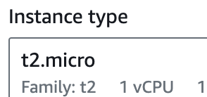





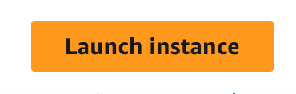
Creating the EC2+ WebHosting
Step 7: Instance Type
Step 8: Key Pair
Step 9: Launch
Root User
Install
Host

Slide 26
08
LESSONS LEARNED

Slide 27
CHALLENGE #1
The Problem:
The Lesson:
Connection failed during testing despite configured environment variables
Tried multiple potential endpoints for host variable
Finally pinpointed and solved issue by configuring security groups for Lambda function
Don't get fixated on what you may think is the problem, and consider potential outside factors as well

Slide 28
CHALLENGE #2
The Problem:
The Lesson:
File from S3 bucket could not be downloaded via Lambda
Created a new Lambda function from scratch, which could download and process the file, and compared them
Only difference was that the original function was in a VPC
I unhooked the function from the VPC and set the host to the public RDS address
Go with what works, even if you don't entirely understand the fine mechanics
Use process of elimination and comparison with working code to pinpoint issues

Slide 29
CHALLENGE #3
The Problem:
The Lesson:
Sometimes the simplest solution is the best solution. Be sure to carefully look over the configurations for your service before it is deployed!
Was unable to connect to AWS RDS from local machines.
Reconfigured security groups, proxies, and VPCs to no avail.
Finally, went through our RDS configurations and noticed that public access was set to “No”.
After changing this setting to “yes” and waiting a couple minutes for the modification to take effect, we were finally able to connect to the database.

Slide 30
CHALLENGE #4
The Problem:
The Lesson:
Was unable to remote connect into the EC2 from a local machine
Even though the key file and EC2 address were correct, my access was denied.
The error message stated my key was not secure enough
This require that I change the permissions on the key file directly through the command line
Read! Very often the system is telling you exactly what you are doing wrong. Understanding error messages can help point you in the right direction to find a solution.

Slide 31
DEMO TIME!
Jira Board
Website

